Slide 1

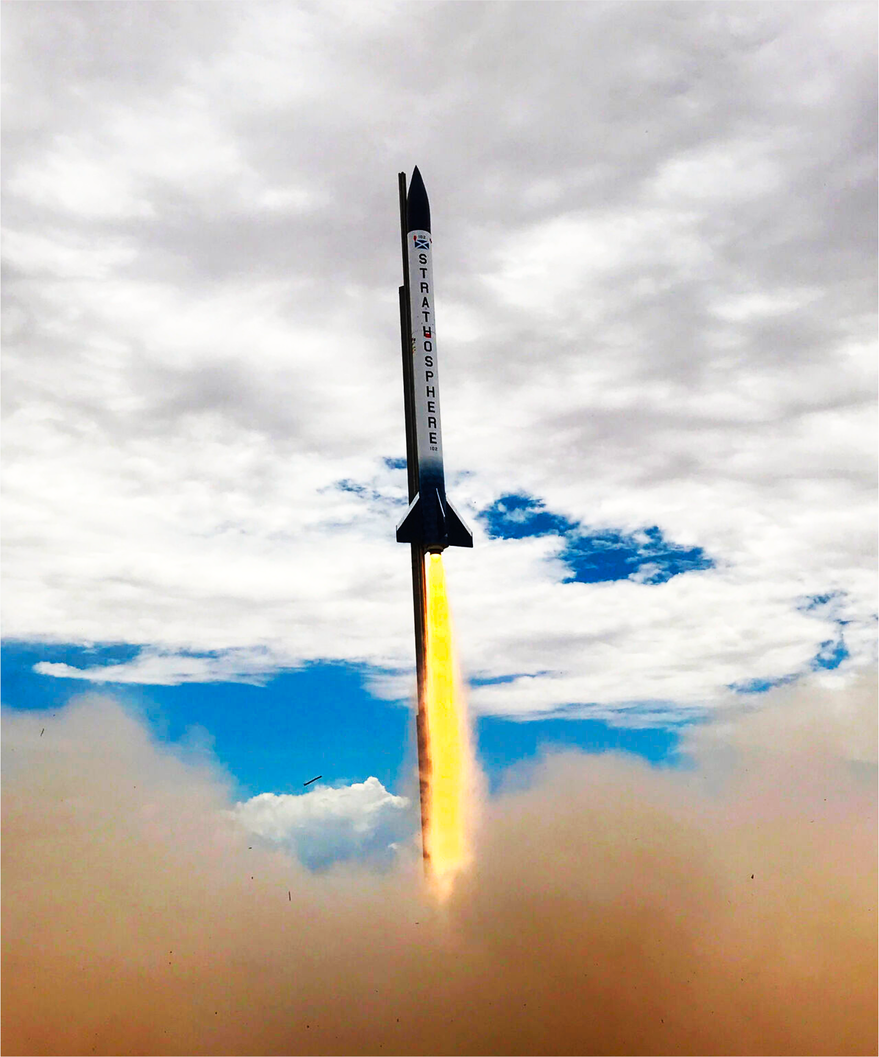
Avionics week 2

Slide 2
What’re we doing this year?
Hardware
SRAD Flight Computer
SRAD GPS
SRAD Radio
Software
SRAD Flight Computer
SRAD GPS
SRAD Radio
Telemetry/Data visualization
Loads of maths
SRAD Flight Computer
SRAD GPS
Telemetry Visualization

Slide 3
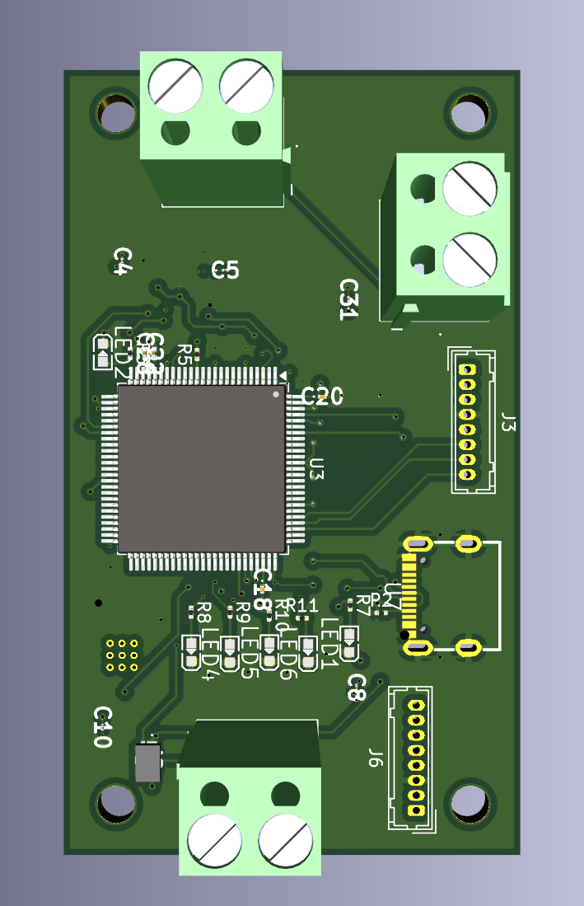
SRAD Flight Computer
This’ll be to control parachute deployments
Get altitude
Figure out how the rocket is moving
Make sure we’re not doing any supersonic weirdness
Deploy parachutes when appropriate
We need software and hardware as well as test plans.
Prior to software there’s some maths that should be done to make sure the Kalman filter’s all good

Slide 4
SRAD Transmitter
Mainly needs hardware done, software is more or less handled on other modules.
Figure out what frequency is best to use.
Get comfortable with RF design.
Not too bad of an intro to pcb design, but it will take a fair bit to make work well.

Slide 5
SRAD GPS
Very early stages of this, the maths behind finding something from distances from some satellites ain’t too bad.
Some maths needs done for that, then software and hardware need made.
Not going to sugarcoat it, this one’ll be challenging.

Slide 6
Telemetry/Data Visualisation
Software project, take in data either recovered post flight or downlinked via a radio during flight and use it to plot the location, orientation and state of the rocket at any given time.
Mixture of just some maths, getting initial values for calibration and then GUI stuff.
Can even import terrain data if you’re feeling real jazzy.

Slide 7
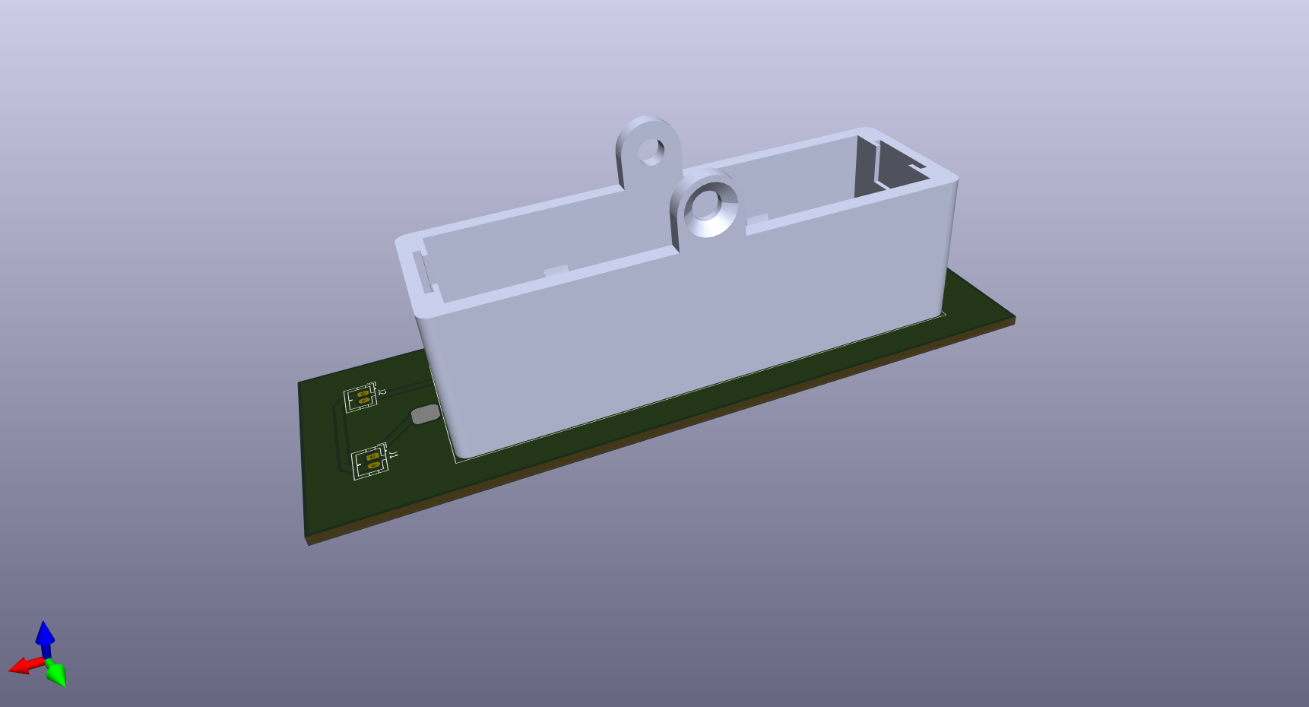
Some more miscellaneous stuff
Simple board for power/cable management and other utilities
This is one where you’s can 100% suggest stuff

Slide 8
You talk at me now
Questions?
Concerns?
Random statements?
Comments?
Inane rambling?
Autistic rambling?
Declaration you’re going to throw a potato at me?
Things you want to suggest we make?
Thing’s you want us to run sessions/tutorials on?

Slide 9
Have I forgotten anything?
I don’t know.
Probably.

